Slide 1
Welcome to APPLIED STATISTICS
Instructor:
Jacob Turner, Ph.D.

Slide 2
Typical Work Flow for Each Unit
Before Live Session: Do asynchronous materials.
Video
Live Session Assignment(s)
Post Questions on the Wall
Submit Live Session Assignment on Canvas
Live Session!
Live session, ready to discuss Live Session Assignment
Homework will be assigned. Completed on your own schedule.
Repeat!
To be clear. There are two assignments per each unit. One before live session and one after.

Slide 3

Grading SCALE
Projects (2) 30% Each
These are the most important to show your progress in the course
1st 2 are your own data sets, last one is group based
Midterms and/or Final 10% each
Designated weeks (7 and 15)
no new material that week
Homework 0%
Homework is assigned after live session
Work at your own pace. I will provide solutions and overall thoughts after roughly one week.
Participation 20% (2 are excused)
Self explanatory (this is grad school)
This include Pre Live Session assignments
Includes attending every Live Session from start to finish (the schedule hour and a half.) This includes not using Video Pause excessively. For an 80’s explanation of the dilemma this causes see the following link from Real Genius! For those of you who have seen the movie, you will enjoy the whole montage! Those who have never seen it, you are in for a treat … please pay close attention to 2:45, 3:10 and 4:35.
https://www.youtube.com/watch?v=CfL8N_bDo1E

Slide 4
What You are going to see / Feel
Online Videos (Asynchronous material)
Uses data sets included in the text book (some are not)
Provides general information of the topic
Depending on the topic, there may be a lot of mathematical detail and jargon that you may not understand given your background
In all, a ton of content and information
SAS session examples
Pre Live Assignments
Basically a single problem (I will provide a data set, start up SAS and/or R, and a series of questions)
This will be an initial starting point, and typically will be used throughout the live session to illustrate other concepts as you are already familiar with the data set

Slide 5
OUR class Goal
“Can’t see the forest for the trees”
Frustrating/Scary part: Loads of contents both in the general information of the topics as well as the mathematical components and learning SAS and all of its options
I will do my best to pinpoint specific sections of video content that are more important. Your job is to watch and read all the content which I view as “the pieces of the puzzle.” There is a method to the madness, I promise.
Our goal is to make sure we have the following nailed down for each topic
What is this technique used for?
When do I use it?
How do I interpret the results from it?
Shortcomings, difficulties, and rules of thumb
Remember the great George Box: “All models are wrong, but some are useful.”
SAS/R basics and learning more from SAS help and R Documentation / Blogs (Cross Validated)
You should go into every week trying to get a handle on these basic questions. Do not stress the detailed concepts until you are comfortable with the high level overview.

Slide 6
How to reach that goal
PreLiveSession - Assignments that we do week to week.
Fill out a 2 or 3 page PowerPoint slide.
You will submit these to Canvas Each Week before the live session.
Live session.
We will begin most Live Sessions by discussing the pre live session question. I will take volunteers or will randomly call someone.
We will continue and extend the discussion of the LS Questions as well as have chalk talks and presentations of examples. I will always be providing a general structure of the statistical method workflow for each method. Fair warning, I will go a little off rails with a couple of units because I will cover methods that will get you farther.
And of course … Answer Your Questions to the best of my ability!
Homework
The homework is meant for you to go back and test your knowledge after live session. If you can do the analysis and explain what the models are saying and doing, then you should be pretty good for the midterm
Projects
The idea here is to work with something a little more complex with issues and concerns that often pop up in reality. This semester your groups are going to pick their own data sets. I can help a little.
Effective communication of analysis strategy and implementation is key here.
Also good practice for midterm
Midterm and Final Exam
We may or may not have these exams. We will see how things go. We are restructuring the course and I can only tackle so much each semester.
Tests will be MC and or free response with a focus on high level workflows, knowing what each method gets you, and correct interpretation.

Slide 7
Projects
I will provide an example of a project students have done in the past as an example. We will be doing it slightly different before, but it could still be helpful. I will also be providing project report requirements and expectations.
Main issues that students have
Making sure they state statistical hypothesis and conclusions correctly
Interpreting confidence intervals and parameter estimates (especially after transformations. I can help if you don’t wait til the last minute)
Organizing the story of the analysis
Labeling Figures and making sure to reference each one in the write up.
No conclusion, just ending, not making sure to consider the potential flaws of the analysis or other logistics.

Slide 8
UNIT 1!!!

Slide 9
Unit 1 Recap and My 2 cents STUDY DESIGN
We are focusing on study design. This key piece of statistical thinking is needed for every analysis method that we learn this semester.
Before data is even collected, we should always seek out every piece of information and understanding of the type of questions the researcher wants to investigate
Basically, think about DESIGN before you analyze.
Helps identify what type of statistical analysis we are going to conduct
Can lead into the sample size needed to have a high chance of seeing a practically significant result to a specific hypothesis.

Slide 10
Key Terms
Subjects / Units: plants, animals, or objects for which effect is measured or observed
Factors: Categorical explanatory variables thought to affect response
Levels: individual categories of factors
Treatments: Combinations of levels applied to subjects, randomized in experiments, etc

Slide 11
Importance of statistical design concepts
Defining the question before analyzing the data
Problematic in some real world scenarios
Big Data (Data snooping)
Do enough hypothesis testing and your bound to find something
If Ho is true and there is no effect at all, 100 tests will give you (on average) 5 false positives (rejections of Ho) (at the alhpa = .05 level)
Other ways to get around it
Cross Validation techniques
Verifying with a completely new data set
Multiple Testing Corrections: Can you name a few?

Slide 12
Importance of Statistical design concepts
Sometimes there is a misconception that an observational study has no design considerations since you can’t control things
How designs still plays a role
Analyses coming from databases
Sampling techniques
Adequately powered sample sizes
What to observe?
Sources of variability
Potential confounders

Slide 13
Missing Data
How does it happen?
Naturally- Truly missing
Human subjects are smart … refuse to answer / pass
Data entry
Other: Samples are collected but do not pass QC
What to do when it happens
Many variations … identify type of missingness: MCAR MAR NMAR
Many techniques:
Observation Removal ( Only with MCAR … but still reduces power)
http://www.theanalysisfactor.com/when-listwise-deletion-works/
May introduce Bias
Imputation
Last one forward (Time Series / Longitudinal Data)
Mean / Median / Mode
Linear and Nonlinear Models (Regression / Logistic Regression)

Slide 14
Breakout session
What are the factors and what are their levels?
What are the treatments?
Are there any blocks in this design?
Critique the design in anyway you see fit. Have fun with it. For any criticism, provide an alternative solution that could help it out in some way.

Slide 15
Breakout Session 1
A metal company wants to test if any any one of 3 different components to their metal making procedure will improve the strength. It is known that all 3 will improve the strength and they all cost the same so they just want to know which of the 3 components provides the best improvement in strength/ Their plan is to run the experiment in a single day so they will generate samples of metal with the different components using 3 separate assembly lines. Each line will be using 1 of the 3 components and will produce 10 metal samples each for strength measurements.

Slide 16
Breakout Session 1
A metal company wants to test if any any one of 3 different components to their metal making procedure will improve the strength. It is known that all 3 will improve the strength and they all cost the same so they just want to know which of the 3 components provides the best improvement in strength/ Their plan is to run the experiment in a single day so they will generate samples of metal with the different components using 3 separate assembly lines. Each line will be using 1 of the 3 components and will produce 10 metal samples each for strength measurements.
Factors: Components Blocks: Assembly Lines
Component1 AL 1
Component2 AL 2
Component3 AL 3
Treatments: Component1, Component2, Component3
We could include the assembly line levels in the treatments except they are redundant here. In statistics we say that the Component factor is “confounded” or “aliased” with the block levels. If we see a significant difference, is it because of the differences in the assembly lines or in the components? Impossible to tell with this flawed experimental design.

Slide 17
Breakout session 2
Vaccine Study
Immunology researchers are often trying to understand how vaccines work and why some people respond positively to the vaccine while others the vaccine has no effect. In this study, researchers are interested in studying the Flu vaccine on 12 healthy subjects and the difference between what is going on biologically between the responders versus the nonresponders. Using certain technology, they are able to define which of the subjects either responded or did not respond to the vaccine after a certain period of time.
Suppose that the classification lead to 6 responders and 6 nonresponders. The response variable is a genetic measurement that is taken from a machine that process the samples in batches of 6, so they decide to equally distribute 3 responders and 3 nonsresponders on each of the 2 batches. It is also well known that the response variable tends to increase in subjects who are older rather than younger. The analyst decides to run a Welch's t-test or Rank sum test to test for differences in means between responders and nonresponders.

Slide 18
Breakout session 2
Vaccine Study
Immunology researchers are often trying to understand how vaccines work and why some people respond positively to the vaccine while others the vaccine has no effect. In this study, researchers are interested in studying the Flu vaccine on 12 healthy subjects and the difference between what is going on biologically between the responders versus the nonresponders. Using certain technology, they are able to define which of the subjects either responded or did not respond to the vaccine after a certain period of time.
Suppose that the classification lead to 6 responders and 6 nonresponders. The response variable is a genetic measurement that is taken from a machine that process the samples in batches of 6, so they decide to equally distribute 3 responders and 3 nonsresponders on each of the 2 batches. It is also well known that the response variable tends to increase in subjects who are older rather than younger. The analyst decides to run a Welch's t-test or Rank sum test to test for differences in means between responders and nonresponders.

Slide 19
Breakout session 2
Bowling study
My buddy Bivin, who was in my cohort in grad school, loves to bowl, but he never has time :(
So he designed his Experimental Statistics II project so he would have a reason to go bowl :)
He had just bought a brand new bowling ball and he wanted to know if it performed better than his old ball. He also noticed that professional bowlers make sure to clean the oil off their ball after every roll. He was curious if this truly had an effect and whether the combination of either cleaning or not with what ball he rolled with works better for me in terms of my score. Since he wanted to assess if an interaction existed between cleaning bowling balls and which ball I bowled with, he made sure he bowled with each treatment 4 times. He ran the entire experiment on a Saturday afternoon. he then conducted the analysis using a two way ANOVA model.

Slide 20
Breakout session 2
Bowling study
My buddy Bivin, who was in my cohort in grad school, loves to bowl, but he never has time :(
So he designed his Experimental Statistics II project so he would have a reason to go bowl :)
He had just bought a brand new bowling ball and he wanted to know if it performed better than his old ball. He also noticed that professional bowlers make sure to clean the oil off their ball after every roll. He was curious if this truly had an effect and whether the combination of either cleaning or not with what ball he rolled with works better for me in terms of my score. Since he wanted to assess if an interaction existed between cleaning bowling balls and which ball I bowled with, he made sure he bowled with each treatment 4 times. He ran the entire experiment on a Saturday afternoon. he then conducted the analysis using a two way ANOVA model.
Factors:
Ball: New and Old
Cleaning: Yes and No
No Blocks: If he would have performed the experiment on two or more lanes or on two or more days, these would have been blocks.
Treatments: 1. New and Yes 2. New and No 3. Old and Yes 4. Old and No
We might have considered adding the Game number to the model as a possible covariate or possibly a block if you look at it right (Beginning (1-4), Middle (5-8), Late Middle (9-12), End (13-16). There is reason to believe that being warmed up or fatigue might be a factor from games 1 to 16 … that’s a lot of games!!!

Slide 21
Blocking / More Depth
If the researcher knows something about the characteristics of the experimental material, it is often possible to group experimental units into sets of relatively homogenous material (blocks), and then compare treatment level means within these groups.

Slide 22

Plant Growth and Fertilizer
4
3
1
3
1
2
2
4
2
1
4
3

Slide 23
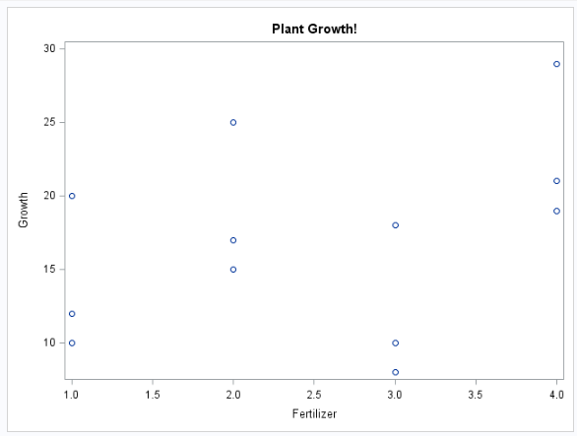
Plant Growth and Fertilizer

Slide 24
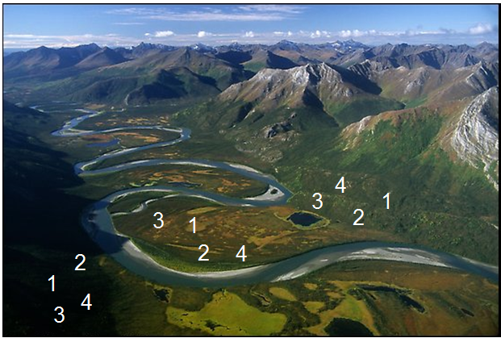
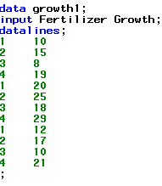

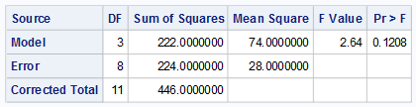
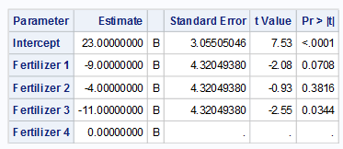
Plant Growth and Fertilizer

Slide 25
Blocking and Control of Extraneous Variation
The main interest in the experiment is the comparison of the four Fertilizers.
The variation imposed on Fertilization by the 3 different plot/soil types represents a source of extraneous variation.
Unless controlled for in the experiment, this variation has the potential to “swamp” or overwhelm the differences among Fertilizers.
High probability of concluding there are no treatment effects when treatment effects are in fact present.
Fair comparisons only occur among fertilization within a plot/soil type.
We wish to use the combined experience across plot/soil types to make a stronger statement about the differences in fertilizers.

Slide 26
Plant Growth and Fertilizer BLOCKED!
4
3
1
3
1
2
2
4
2
1
4
3

Slide 27
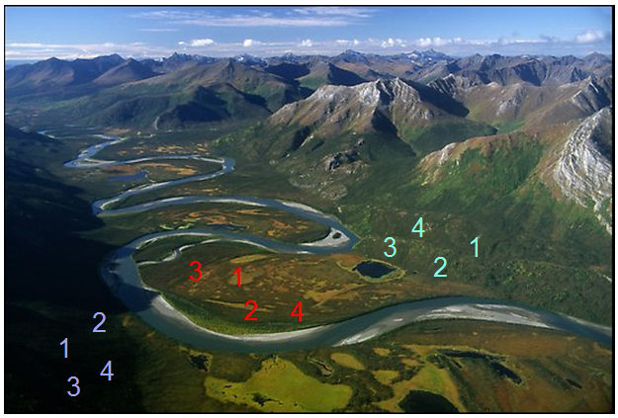
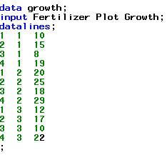

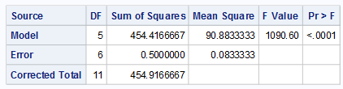
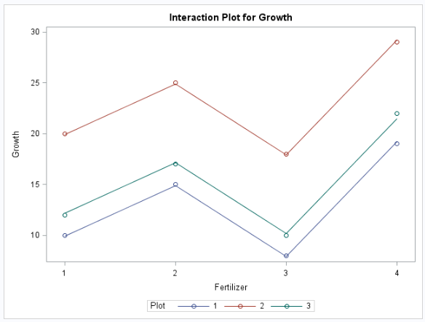
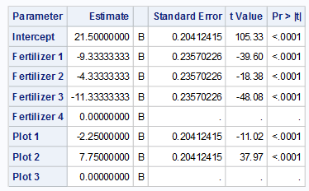
Plant Growth and Fertilizer

Slide 28
Conversation about sample size
Assignments from the book are good practice to try to determine appropriate sample sizes.
Currently they are just formulas to you without any real context.
The best way to think of it right now is based on your knowledge of the 2 sample t-test
What I like about the two problems is that they present the problem that reflects real world situations
No one simply tells you this is the difference I want to detect, this is my estimate of variability, now tell me my sample size?
It usually is a conversation where the statistician has to tease out this sort of information any way they can.
Like the Chapter # indicates, we are getting a little bit ahead of ourselves as we really need to understand the analysis method first before we really can dig into sample size calculations.
A lot of times, more complicated problems are reduced to a more simplistic view of the problem in order to obtain sample sizes

Slide 29
IMPORTANT FACT Not UNDERSTOOD by Nonstatisticians
Sample sizes obtained in power calculations provide some guarantee of rejecting the null hypothesis under certain alternative scenarios (means are different by 10, etc).
Increasing sample sizes does not guarantee your model will get better in terms of their predictive ability!
We will see this at play later down the road.

Slide 30
Sample size calculations
If we:
Know the difference we want to detect
Have a decent idea of what the variability is going to be
The only unknown quantity in our t-statistic is the sample size n. We can essentially move n around (make it smaller or bigger) to achieve a good probability of detecting the difference.
Reminder: The sample size calculation is directly related to which test you are going to conduct. So if you are doing a test for the mean using a t-test, you would use the properties of the t-test to determine sample size. For other tests that are based on the z-distribution, chisquare, etc., those properties would then be used.

Slide 31
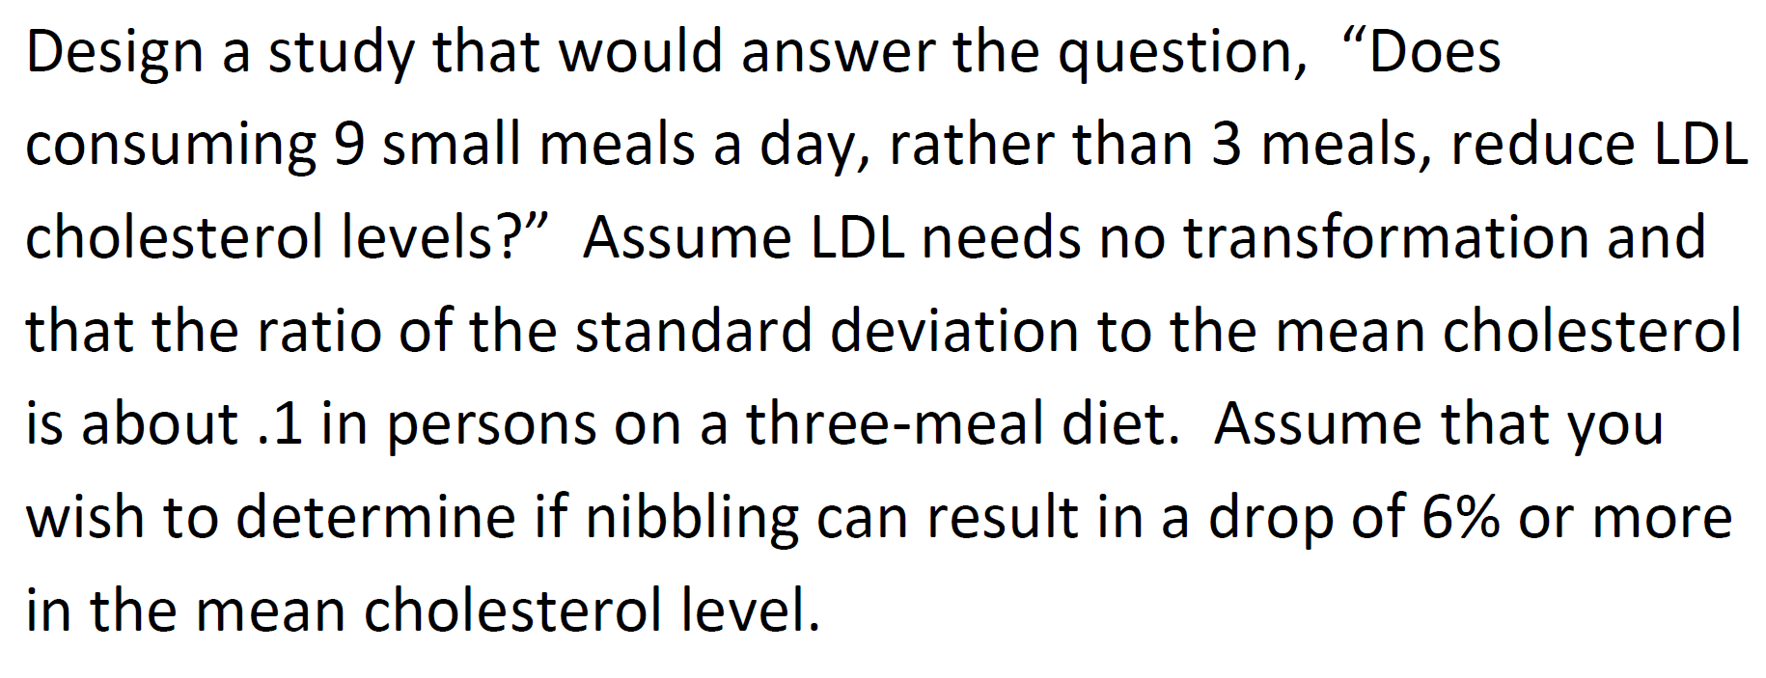
Experimental Design and Sample Size Calculation
In your analysis the client is also very interested in the sample size that will be necessary to perform the test that is suggested to answer the question outlined above.

Slide 32
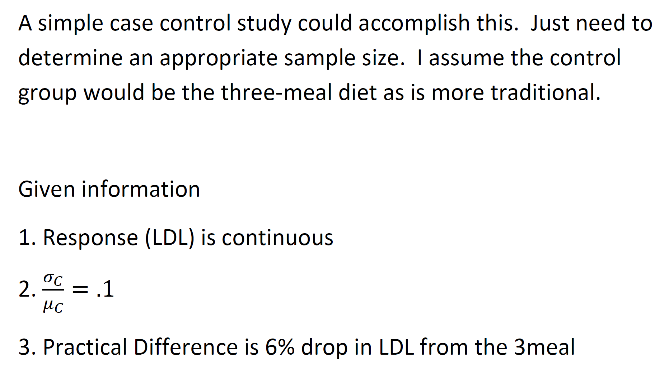
Experimental Design and Sample Size Calculation

Slide 33
GLMPOWER
data result;
do diet = 1 to 2;
input LDL @@;
output;
end;
datalines;
100
94
;
run;
proc glmpower data=result;
class diet;
model LDL = diet;
Power
stddev=10
ntotal = .
power = .8
;
run;
The GLMPOWER Procedure
Fixed Scenario Elements
Dependent Variable | LDL
Source | diet
Error Standard Deviation | 10
Nominal Power | 0.8
Alpha | 0.05
Test Degrees of Freedom | 1
Computed N Total
Error DF | Actual Power | N Total
88 | 0.804 | 90

Slide 34
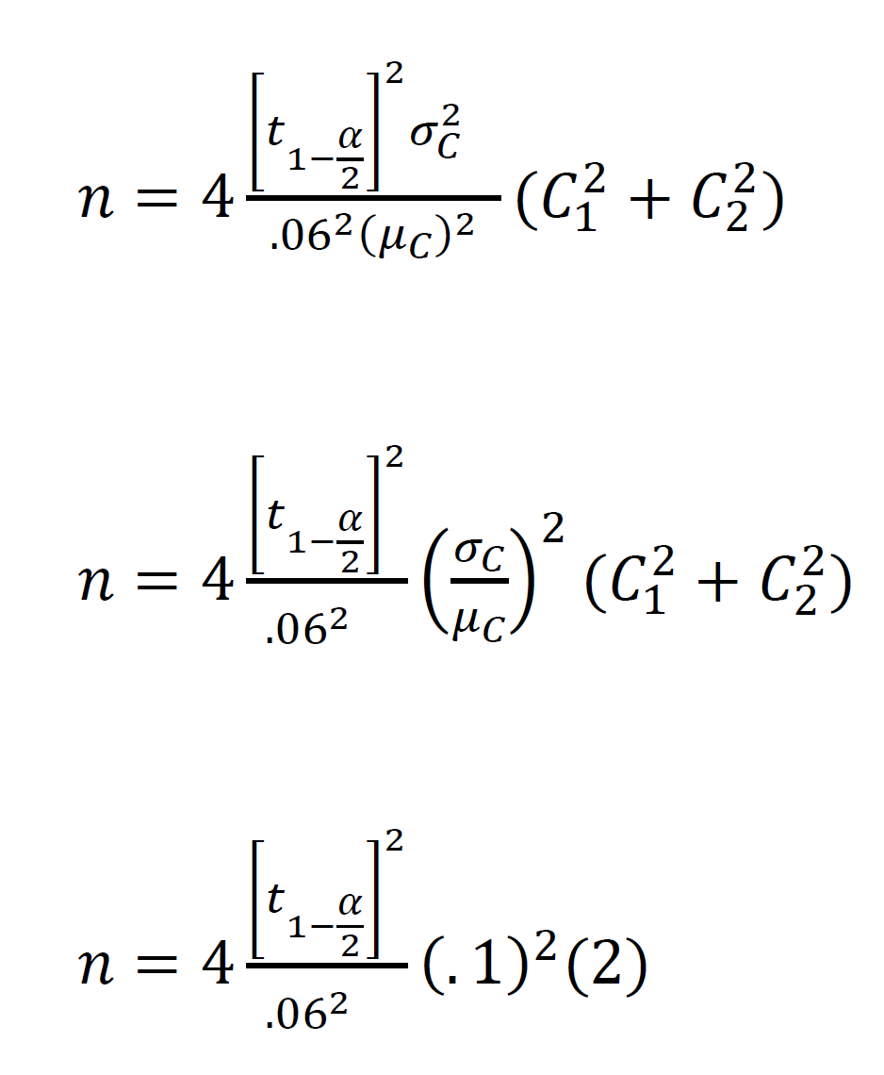
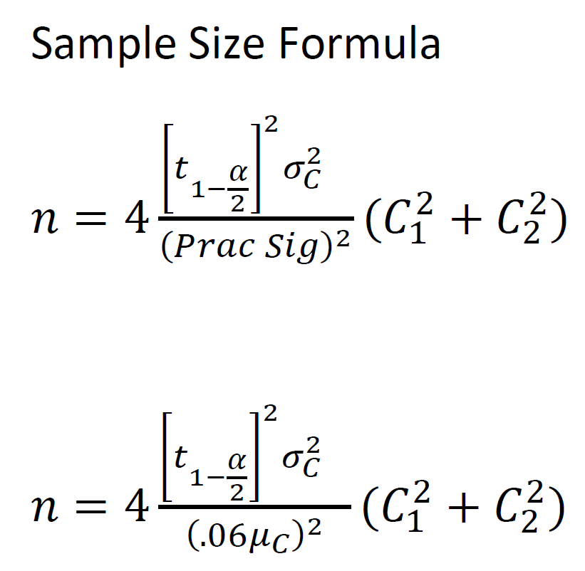
Experimental Design and Sample Size Calculation

Slide 35
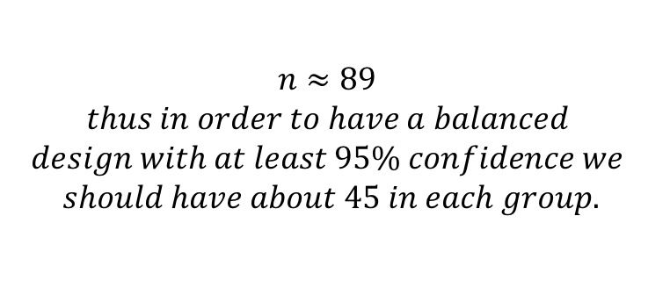
Experimental Design and Sample Size Calculation
$$n≈89$$
$$thus in order to have a balanced$$
$$design with at least 95\% confidence we$$
$$should have about 45 in each group.$$

Slide 36
Next Week UNIT 2
Videos.
LARS and LASSO have some complicated portions of the videos. They are important but I will present to you a general idea of these methods with a simple graph rather than the math. Supplementary literature posted in 2DS supports these methods over the original Forward, Backward, and Stepwise methods
2.4, 2.6, 2.8 are the main components
2.7 and 2.8 are also helpful but we need more info for 2.8
Live session
General multiple regression analysis concepts, overview (Including VIFs)
Using model selections and a deeper discussion into 2.8 with cross validation
The assignment will start us out with these two components and I will jump into some more discussion from there (Look out for pre live session work assignment and hw)

Slide 37
End of Lecture
Slides from here on are a review of power and the effects of sample size, variance and effect size on the power!

Slide 38
Sample Size Calculation Main Idea
Hypothesis Testing
 |  | Truth
 |  | H₀ | H_{A}
Result | H₀ | Correct | Type II Error
 |  |  | β
 | H_{A} | Type I Error | Correct
 |  | α | Power=(1-β)

Slide 39
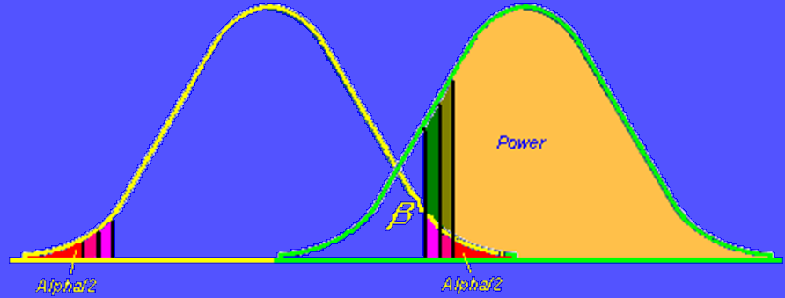
Sample Size/Power Calculations
Rejection Region
Mean=0

Slide 40
Sample Size/Power Calculations
Mean=0
Null H0
Mean=3
Alternative HA

Slide 41
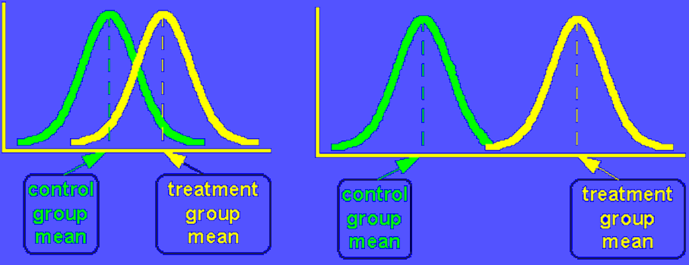
So bigger differences make it easier to reject (More Powerful)
Directly relates to the numerator of
The t-statistic
Don’t confuse these figures with the previous slide. That slide is for the distribution of the t-statistic. These are essentially the sampling distributions for the means of the two groups we are conducting the two sample t-test with.

Slide 42
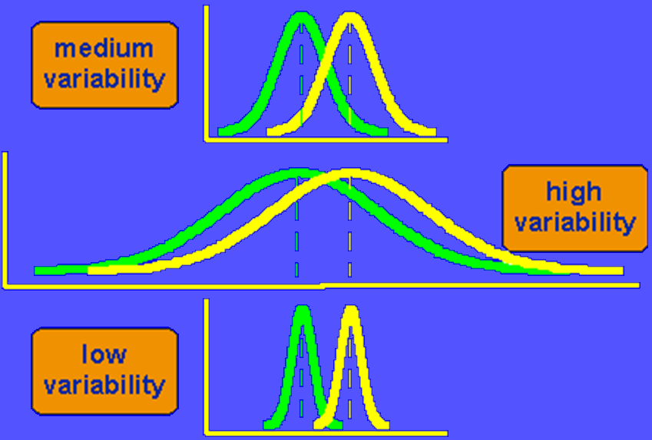
Variability also plays a role

Slide 43
Sample size calculations
If we:
Know the difference we want to detect
Have a decent idea of what the variability is going to be
The only unknown quantity in our t-statistic is the sample size n. We can essentially move n around (make it smaller or bigger) to achieve a good probability of detecting the difference.
Reminder: The sample size calculation is directly related to which test you are going to conduct. So if you are doing a test for the mean using a t-test, you would use the properties of the t-test to determine sample size. For other tests that are based on the z-distribution, chisquare, etc., those properties would then be used.

